Slide 1

Scaling Apps Discovery Strategy for
Peeyush Vardhan
peeyushvrdhn@gmail.com | +919515456727

Slide 2
Challenge, Research and Assumptions
Challenge:
Define a product strategy for apps discovery in Microsoft Teams that integrates seamlessly into the app’s existing UI in iOS. The apps discovery strategy should serve users to discover applications on Microsoft Teams platform based on their interest, need, organization and recommendations.
Background:
Microsoft Teams has become the new way people connect, collaborate, and accomplish more with a new class of applications that break down barriers between business processes and collaboration. Designed to reduce context-switching, the Teams platform has a growing number of collaborative apps. These apps can be embedded directly into Teams or integrate components of Teams such as meetings or chat—right in the interface of the applications.
Our goal is to solve for app discovery on Microsoft Teams?
How can current users discover new apps on MS Teams platform
How MS Teams app can scaled to Target users by different promotional and acquisition channels
Assumptions:
Target Users:
Corporate Licensed users
New acquisition of target users – Corporate employees of large and medium enterprises.
Platform consideration:
Microsoft teams desktop app – Windows and Mac

Slide 3
Research & Empathize
Market Research
Provisional Personas
User Interviews
Target User Persona

Slide 4
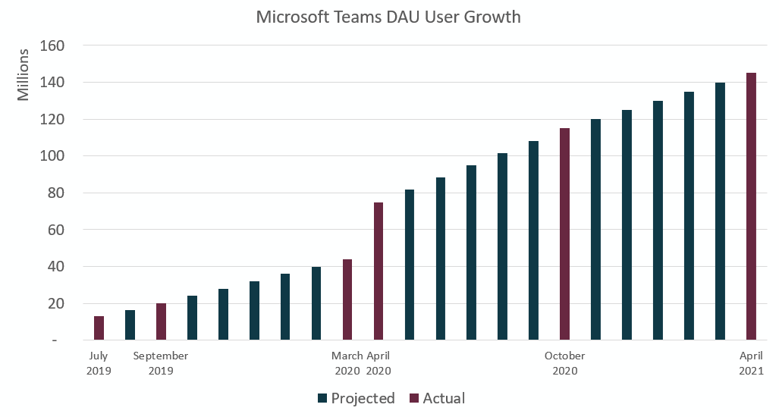
Market Research
Microsoft Teams (communications and collaboration platform) has 270 million monthly active users in the December quarter of 2021
No. of MAU increased by 20 million from July 2021
Major competitors: Slack (Acquired by Salesforce), Zoom, Cisco Webex
Around 50% of Microsoft 365’s 260 million+ commercial users now use Teams. Hence, estimated generated revenue of Teams is between $4 and $8 billion.
In global circumstances since early 2020, 62% of communication service providers reported more than a 50% increase in demand for team collaboration services - The demand for consolidated communication services, in the form of collaboration apps, boomed and Teams sat in a prime position to capture huge swathes of the market than it’s mentioned competitors.
Number of daily active users (DAU) of Microsoft Teams worldwide as of April 2021 (in millions)
Source: Cavell and Statista

Slide 5
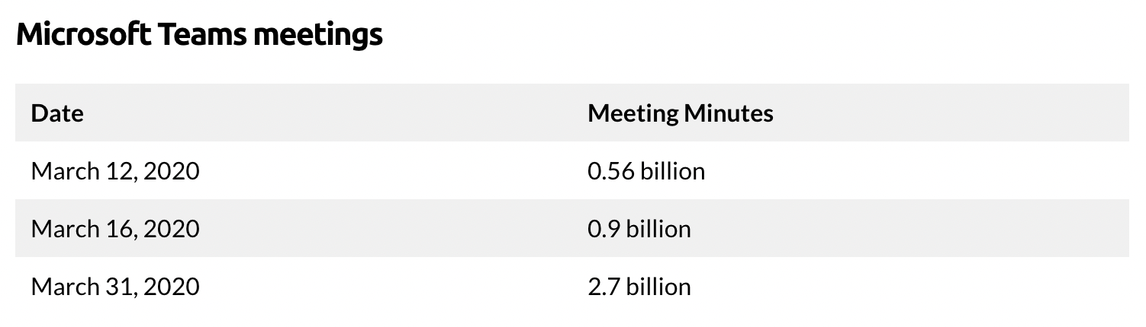
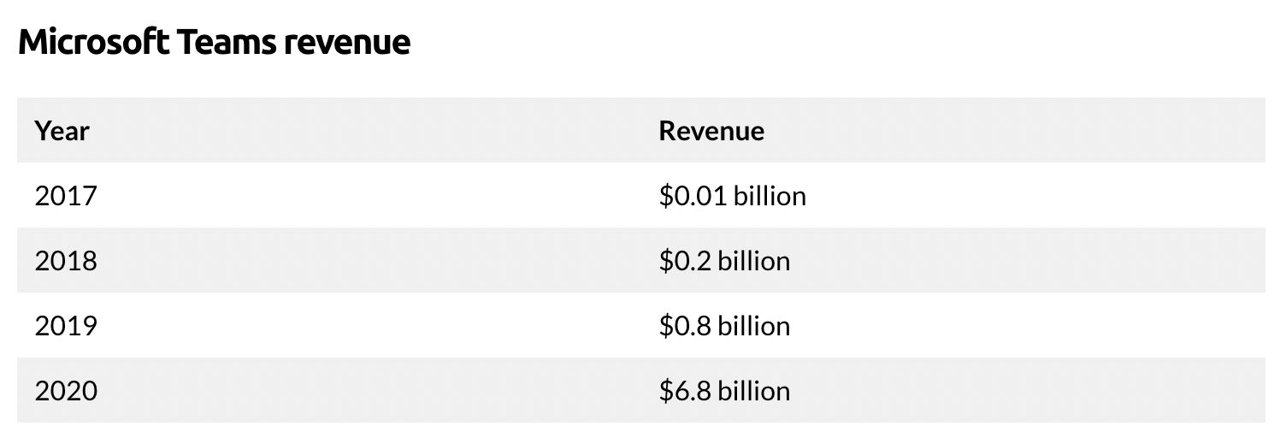
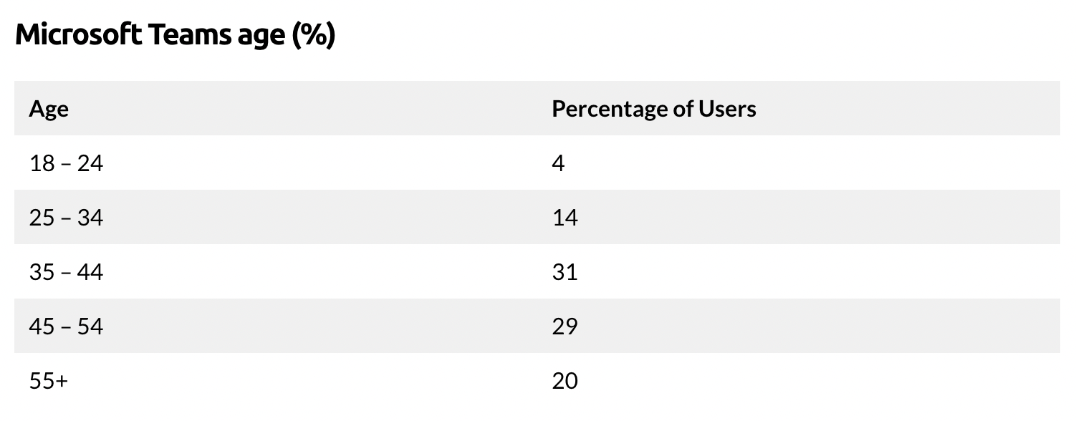
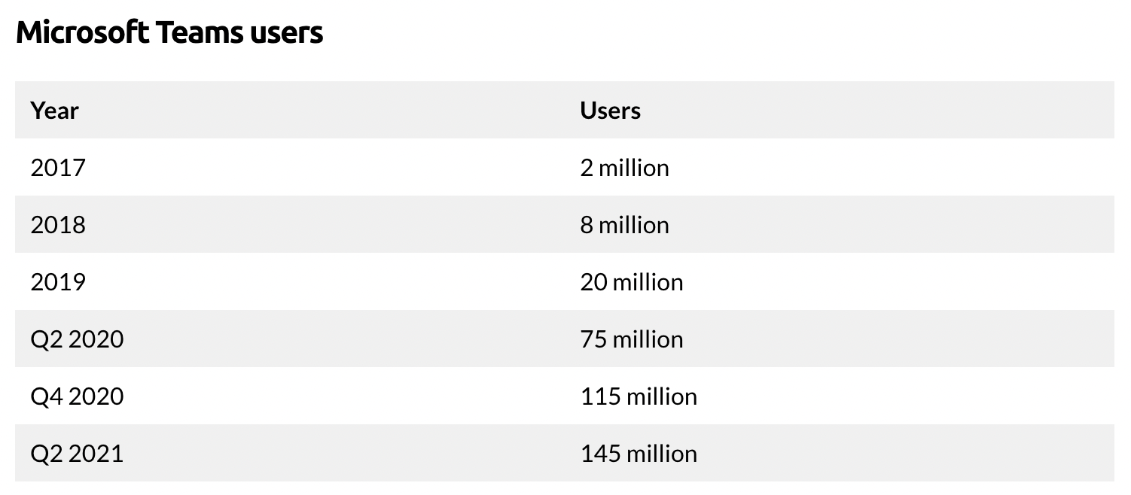
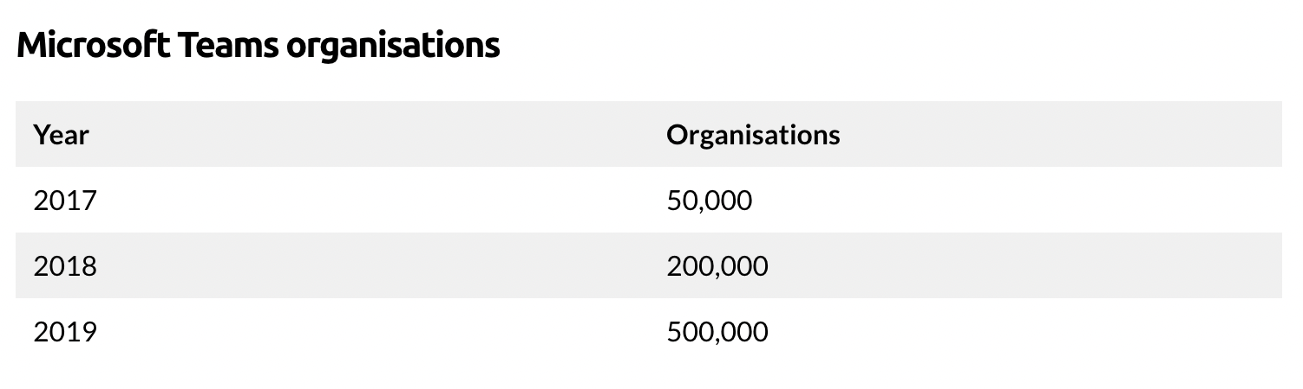
Microsoft Teams Microsoft Teams Revenue and Usage Statistics:
Source: Business of Apps and Microsoft

Slide 6
Provisional Personas
Ashish Kumar Age: 36 New Delhi, IN Occupation: Marketing Head
Needs:
MS Teams is our official communication platform with corporate license with MS Office.
We use Teams for internal and external communication, file sharing and brainstorming.
Pain Points:
It crashes too often during meetings and slow to load.
It is complicated to collaborate on MS Teams, and tough to find associated apps quickly, as many times we don’t know what is the suitable app for a specific need.
Ram Vikas Age: 27 Hyderabad, IN Occupation: Business Development Manager
Needs:
MS Teams is our official communication platform, and it is easy to use.
It’s safe to share documents on MS Teams due to Microsoft’s safety and security offerings.
Pain Points:
It has a got various apps and sometimes it’s overwhelming as we don’t know what’s the right app.
I cannot find find many apps at left shortcut bar. To find a specific app, I must scroll through all applications and find the app I need.
Shivani Das Age: 25 Dubai, UAE Occupation: Research Scientist
Needs:
Uses MS Teams for communication with her team, sharing documents and collaboration with colleagues.
Feels MS Teams is very easy to use.
Pain Points:
The screen freezes during the calls.
I don’t make most of the platform and wish I could know more about the features and integrated apps.

Slide 7
Provisional Personas
Gautam Kumar Age: 44 Dubai, UAE Occupation: Head of Operations
Needs:
Teams is rather much easier tool than other plethora of tools available also with introducing the chat and status availability from outside the organization, it has become popular tool to use across organizations.
I use many apps like power BI, tasks etc. however there’re not too many apps available like Office 365
Pain Points:
Voice missing or cracking issues specially when using video and with large audience.
We can only install apps subscribed by our organization and hence not much leverage. Also there is very limited app availability, and we cannot even preview some of the apps and request for subscription from company.
Anuj Jha Age: 25 Bengaluru, IN Occupation: Data Scientist
Needs:
MS Teams is our official communication platform, and it is a user friendly platform.
Helps in keeping things at one place – it acts as a one space for communication, file sharing and collaboration
Pain Points:
While not installed the app on laptop, we face issue while connecting to the meeting through browser
Plus, when too many people are in group, speaker and ppt shared sometimes not seen properly, also, when any media is played in a meeting of more people then it stuck sometimes or the audio/video desync
There are multiple apps available on Teams, but people (My team and I) mostly are not knowing what are different apps available for teams and the features of it, and when to use the right app.

Slide 8
User Interviews
Total Participants: 12
Questions:
Experience using MS Teams, likes, dislikes, problems
How do you discover new apps on teams? Experience with exploring and installing new apps.
Anything they’d want to do to discover new app? (How would they approach)
Insights from responses:
Participants age group: 24 to 45
Majority of participants see MS teams as a video meeting and chatting platform only.
Participants reported having regular audio lag, video/media desync and bandwidth issue with Teams.
There are times when they tend to explore the apps available on MS Teams, it feels overwhelming as there are too many applications available and they cannot discover which is the right application for them.
Participants stated that, collaboration seems difficult a lot of times on Teams, as app plus video sharing becomes difficult and it desync with audio as well.
There are no way that based on the role they could get personalized experience of the applications that would accelerate their performance and collaboration with the colleagues.
Apps cannot be recommended to colleagues using the Teams platform, and they cannot preview all apps as only subscribed or licensed apps by the organization is available to experience.
There is no quick user guide available for the first-time users or first-time visitors of the apps. Participants were curious to know how a particular app will help them in their work, are there samples available, how can we know about these apps on different channels, are there any reviews and many more.

Slide 9

Target User Persona
For Ashish, Microsoft Teams is an essential part of his daily routine. He attends morning team catchup on MS Teams, and then the routine of cross-functional connects, collaboration and stakeholder connects continues on Teams. Being a father of a toddler and working from home, team helps him attending some of the calls through mobile, so it helps him assisting his daughter in her basic works. He’s using MS Teams since last 3 years and became a company sponsored user about 2 years ago after the COVID pandemic and remote work routine. His job requires him to be highly cross functional, strategical, planner and mentor to juniors. Being a marketing head in a media and communications industry his KRA is to oversee planning, pitching, marketing and execution of large-format IP initiatives and branded-content campaigns across Network18's English and Business cluster platforms in TV, Digital and Print; namely CNBC-TV18, cnbctv18.com, CNN-News18, news18.com, Forbes India, forbesindia.com, CNBC Awaaz, Firstpost, Overdrive, moneycontrol, History-TV18, Better Photography, Better Interiors and other group platforms (Hindi and regional). So, his role involves direct growth of the subscriber base of Network 18 group.
As he needs to be involved in planning and decision making with internal and external stakeholders, he needs a platform to share files with privacy assurance. Being a mentor to juniors, he must work with young brains, and professionals from versatile fields, hence he has to be hands on understanding new point of views, and act accordingly to new queries. A lot of times, there are key moments of collaboration on new problems which require some of the software to solve those critical issues. It is not always easy to know which would be the best app available on Teams, or related to the nature of problem, what would be the suitable software to use.
Ashish, tries to be agile and knowledgeable so he can be a good collaborator, and a problem solver. He stives to explore the Teams platform, it's apps and other available resources on the internet.
Name: Ashish Kumar
Profile: LinkedIn
Occupation: Marketing Head, Network 18
Location: New Delhi, IN
Time Spent on MS Teams: 6-7 hours per day
Personality: Ambivert
Tech Knowledge: Internet, Software, Mobile Apps, Social Media

Slide 10
Needs
MS Teams is our official communication platform with corporate license with MS Office.
We use Teams for internal and external communication, file sharing and brainstorming.
Goals
Easily share new apps on teams based on the needs and teams I’m collaborating with.
It would be easily to have an app categorization based on the nature of the need or personalized to my work area and collaborators.
More knowledge about the apps on Teams platform, their usage, demo, and preview for learning perspective.
New app recommendations by MS Teams or colleagues, based on the needs and easy access option to help in seamless discovery.
Name:
Ashish Kumar
Profile:
LinkedIn
Occupation: Marketing Head, Network 18
Location:
New Delhi, IN
Time Spent on MS Teams: 6-7 hours per day
Personality: Ambivert
Tech Knowledge: Internet, Software, Mobile Apps, Social Media
Frustrations
Too many apps on the list are overwhelming, and cannot decide which is the right app.
Discover new apps based on the needs are tough, and categorization based on the roles within the department is not available.
Not having knowledge of usage and benefits of the apps create a tough situation to pick the right app.

Slide 11
Goals and definitions:
Business & User Goals
Features to enhance user experience
Consumer marketing initiatives to improve user awareness
Focus success metrics
Upgraded User Onboarding – Empathy Map

Slide 12

New users should be able to find apps recommendation and feature details after signing up.
Current users can preview apps based on their work profile, interest and popular apps
Users can recommend apps to their colleagues on MS Teams platform
Target users can find the details/ mini tutorial/ CX demo on community channels, social media and video streaming platforms
Business Goals
User Goals
Increase the app discovery on MS Teams platform by boosting user engagement.
Customer awareness about the MS Teams’ apps on social, streaming and other channels.
Maintain Microsoft’s branding, user experience and style, so the users will get a taste of Microsoft ecosystem experience
Turns users into brand advocates, and increase the NPS of the MS Teams apps.
Discover new apps on MS teams, it’s features and engage with the apps.
Understand the business use of the apps and understand the productivity hacks.
Recommend MS teams’ apps to colleagues, boost collaboration through apps.
Business Goals
User Goals
Technical Considerations
A design that clearly shows users options to find their desired apps and helps in finding new apps.
Maintain constant UI design and familiar user experience to integrate recommendation feature.
Technical Considerations
Keep user experience and UI design familiar to the users
A seamless, smooth and bug-free recommendation feature within MS Teams platform

Slide 13
UX upgrade: Defining Goals and Priorities
Priority Level | Priority 1 | Priority 2 | Priority 3
Goal | Apps discovery based on the user groups. | Upgrade the user onboarding and recommendation | Profession based trainings
Feature | Users will be allowed to explore apps based on the job role, age-groups, professional interests. A categorization menu will be available on left side for seamless discovery of the apps suitable to user. Users can recommend apps to their friends and colleagues with a quick note of it’s use (personalized message). | User friendly onboarding for the first-time users. Data collection of users profession, job, interest, age group to recommend the best suited apps on MS Teams platform. An engaging and visual tour of the platform covering the recommended apps. | Users can avail trainings of apps or application suites based on their profession and job role on MS Teams platfrom. Training of how to effectively use multiple apps while collaborating and search of applications based on the need.

Slide 14
Consumer Marketing: Boost user awareness
Revenue
Retention
User Experience
Focus Pillars:
Priority Level | Priority 1 | Priority 2 | Priority 3
Goal | Target user marketing | User awareness through educational content | Interactive blogs
Feature | Target groups: Professional communities, skill specific channels, LinkedIn, and search ads. Short video ads to summarize the steps to find application, how to collaborate and target user communities Ads on social platforms, communities and streaming platforms about apps recommendation features. | Short video/reels elaborating the apps features. Profession specific video tutorials about apps, collaboration methods and productivity hacks on streaming and social platforms. Publish user experience reviews or organizational experience reviews and their story on streaming platforms. | Publish user interactive blogs by using data visualization. Interactive blogs will allow users to visualize the user experience by clicking on options and end result will take users to the specific apps on MS Teams platforms. Social publishing and Microsoft blogs prioritizing user interaction methods to help target users to get a taste of Microsoft specific user experience

Slide 15
Success Metrics:
Focus Metrics: AARRR [Acquisition, Activation, Retention, Referral and Revenue]
Metrics | Acquisition (or Awareness) | Activation | Retention | Referral | Revenue
Description | How are people discovery apps on MS Teams platform? | Are these people taking action we want them to? | Are our activated users continuing to engage with discovered apps? | Do users refer other users about new/discovered apps? | Are users willing to continue the purchase/license?
How to measure? | No. of new visitors No of redirected users from the campaigns. | MAU on apps No. of returning users | Avg time spent by users Positive review counts | No. of apps referred to colleagues New users count after referral | Continued license by organizations

Slide 16
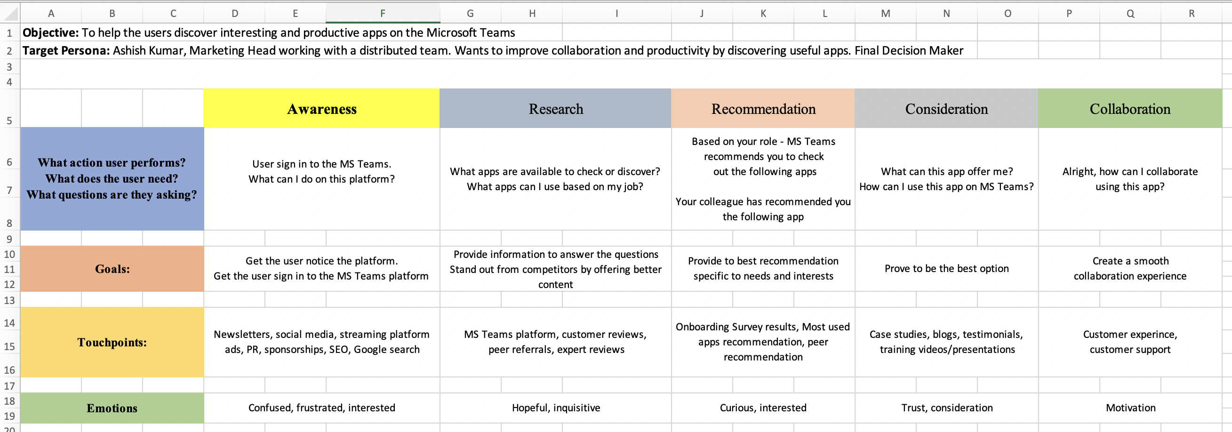
User onboarding upgrade: Recommendation

Slide 17
Questions?
Thank you!

